Slide 1
Portfolio
REBECCA SULTANA
Project Proposal
CSE-0402|E-commerce and Web Engineering Lab
Dept. Of CSE
State University Of Bangladesh
Submitted To: Khan Md. Hasib (Lecturer)
Dept. of CSE
SUB.
July 29, 2021

Slide 2
Overview
Introduction
Development Tools
Project features
Conclusion

Slide 3
Introduction
A portfolio provides a collection of evidence that is gathered together to show a person's learning journey over time and to demonstrate their abilities.

Slide 4
Introduction to Development Tools
Create module I am using Php.
User interface design with HTML, CSS, JavaScript.
Web browser requirement such as Mozilla / Chrome / Edge (anyone).
Using XAMPP / Wamp (anyone) for run program.

Slide 5
Project features
Home
About
Skills
Experiences
Edifications
Contact

Slide 6
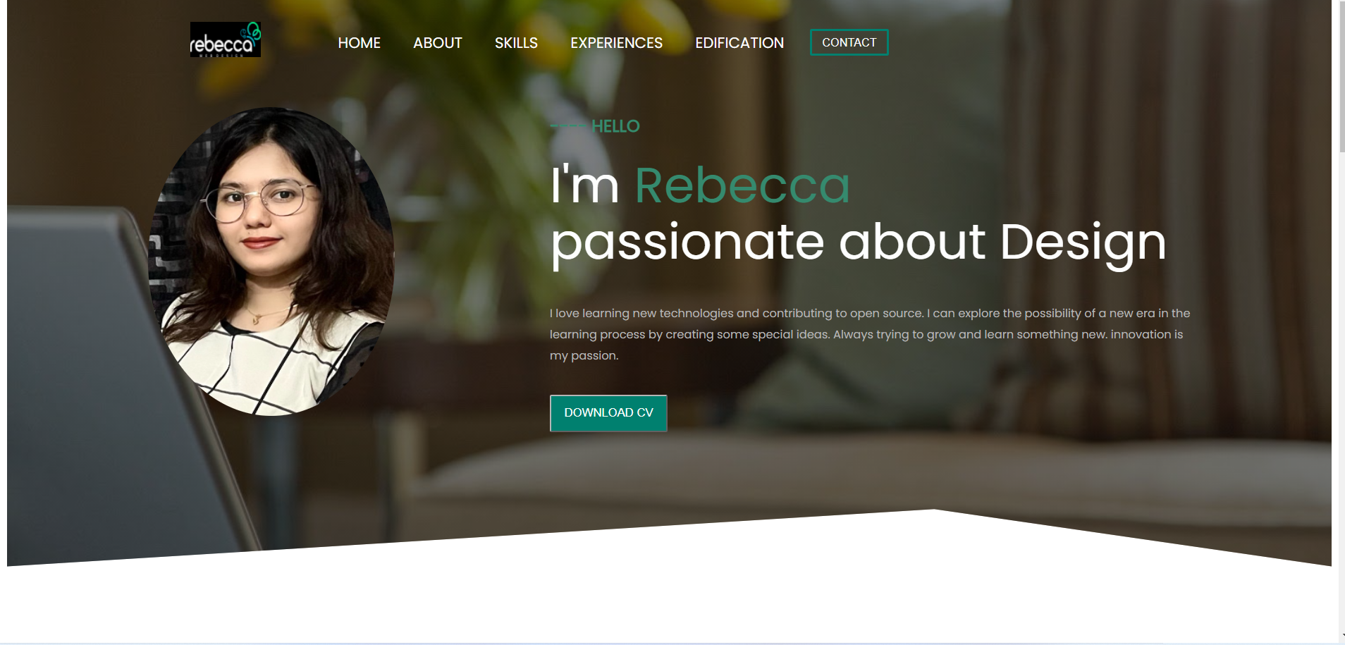
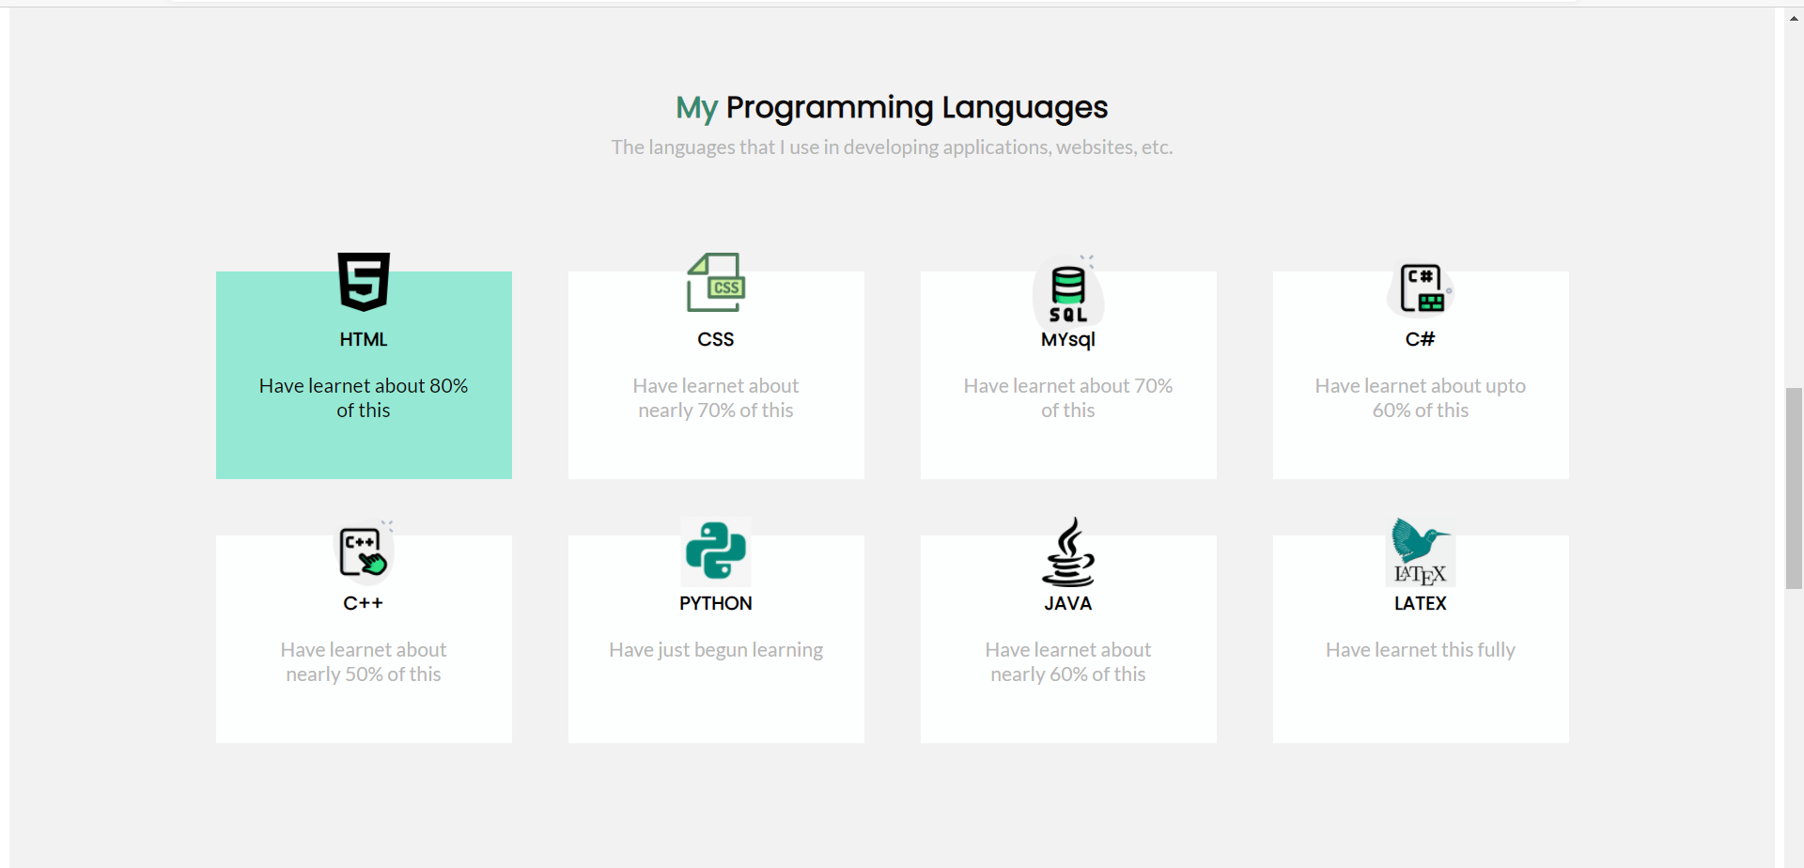
My portfolio

Slide 7
Conclusion
This portfolio project can contribute to my personal development planning.

Slide 8
THANK YOU

